Slide 1

Identification of the Causal Impact of Bike Safety Laws on Cyclist Traffic Accidents Using the Synthetic Controls Method
By NARMINE BEN AISA AND Katherine Games

Slide 2
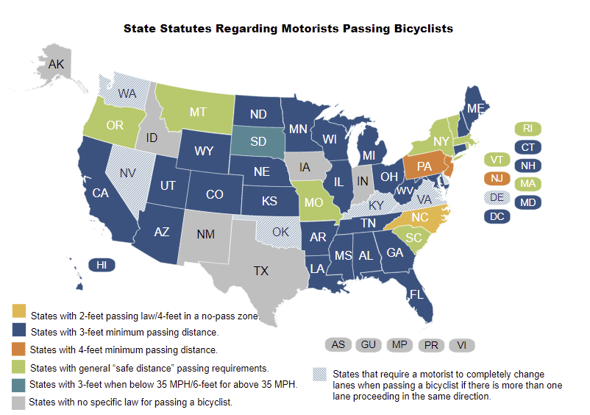
Traffic Laws for Cyclists
Every state in the US has varying laws concerning safe passing distances for cyclists on the road
However, only five states have an extreme law requiring a motor vehicle to completely change a lane to pass a cyclist
Notes:
https://www.ncsl.org/research/transportation/safely-passing-bicyclists.aspx

Slide 3
Our Research
Determine the causal impact of a motor vehicle lane changing law enacted on July 18, 2018 in Kentucky using Synthetic Controls.
Should this law be enacted in other states if it truly reduces motor vehicle accidents involving a cyclist?

Slide 4
What are Synthetic Controls?
“Arguably the most important innovation in the policy evaluation literature in the last 15 years” (p.3) – Athey and Imbens
Chooses a sets of weights for control units and creates an estimated counterfactual for the treatment unit. This synthetic counterfactual shows what would have happened to the aggregate treated unit if the treatment never occurred.

Slide 5
Limitations and Good Practices for Synthetic Controls
Critics argue that you can “cherry pick” the weights given to control units with different covariates and time periods
Not accounting for unobservable confounders over time
Need to choose multiple specifications and add more time periods to reduce these issues

Slide 6
Synthetic Controls Step-by-Step
1. Create a specification which closely aligns treatment and synthesized units to 0 pre-treatment
2. Apply this same specification to the other control units
3. Calculate the RMSPE for both pre and post-treatment for every unit
4. Compute a ratio of the post to pre-treatment RMSPE
5. Sort the ratios in descending order from greatest to smallest
6. Find where the treatment unit’s ration is in the distribution and use as a p value = RANK/TOTAL
7. If it is significant, it will meet the criteria for p < .05, meaning that it is an extreme effect compared to the controls
Notes:
Post RMSPE should be big for the treated unit, meaning it doesn’t follow with the controls

Slide 7
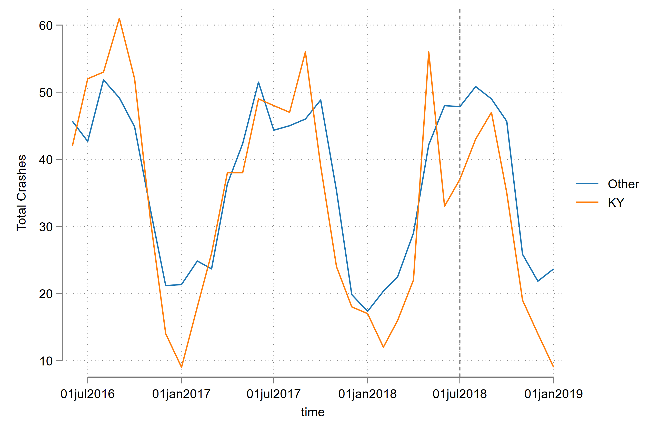
Data Summary
Notes:
Note no parallel trends

Slide 8
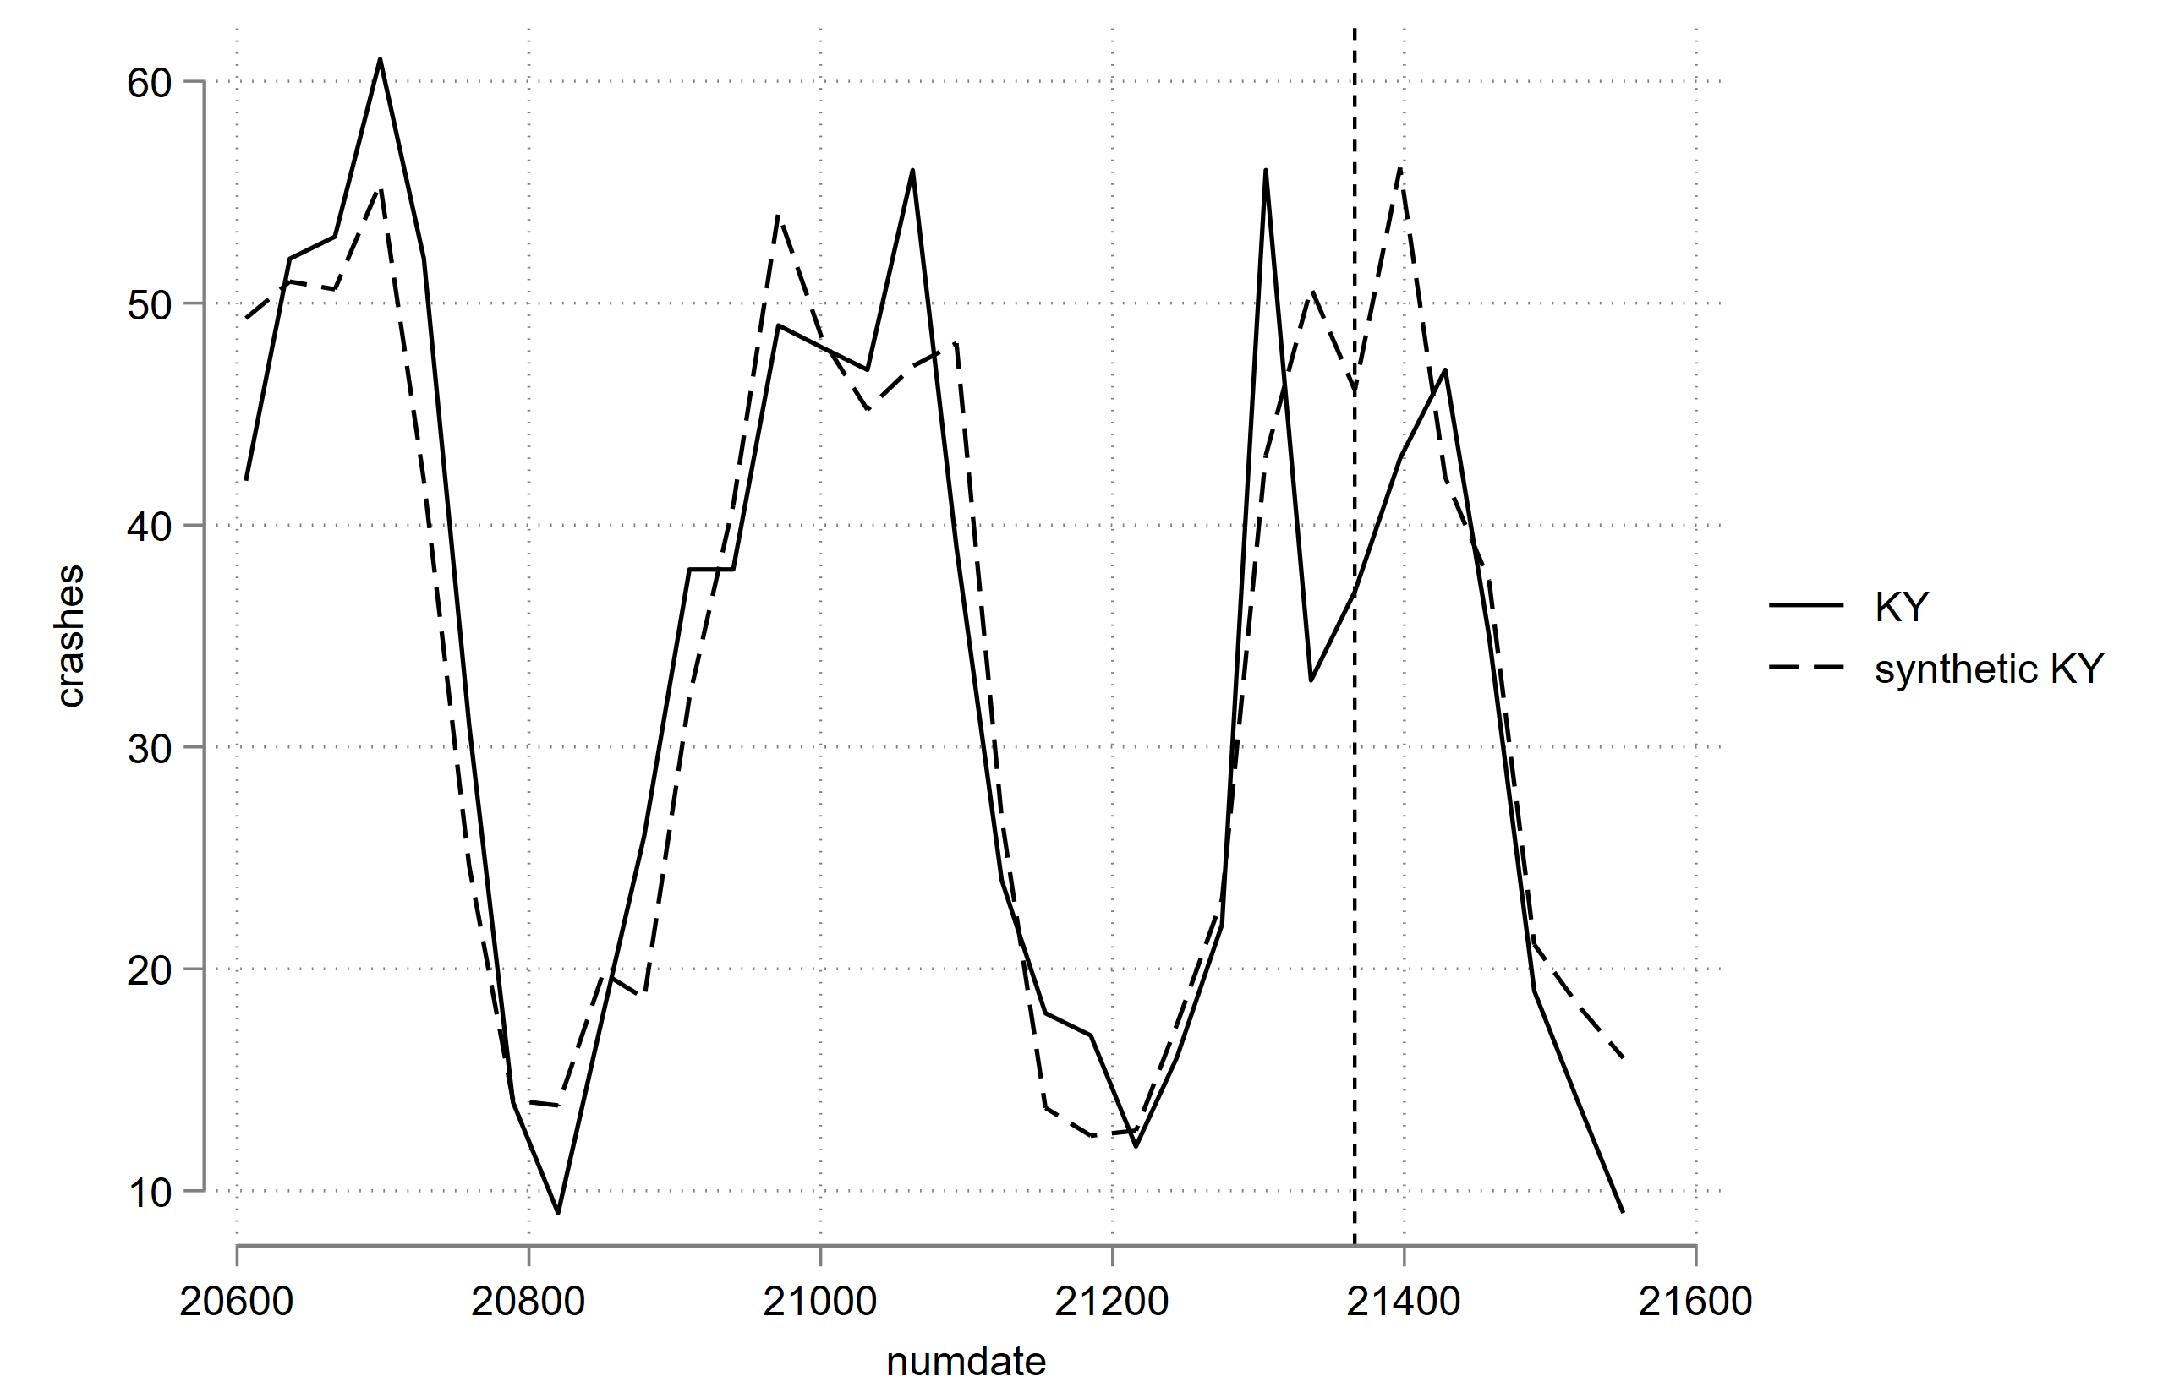
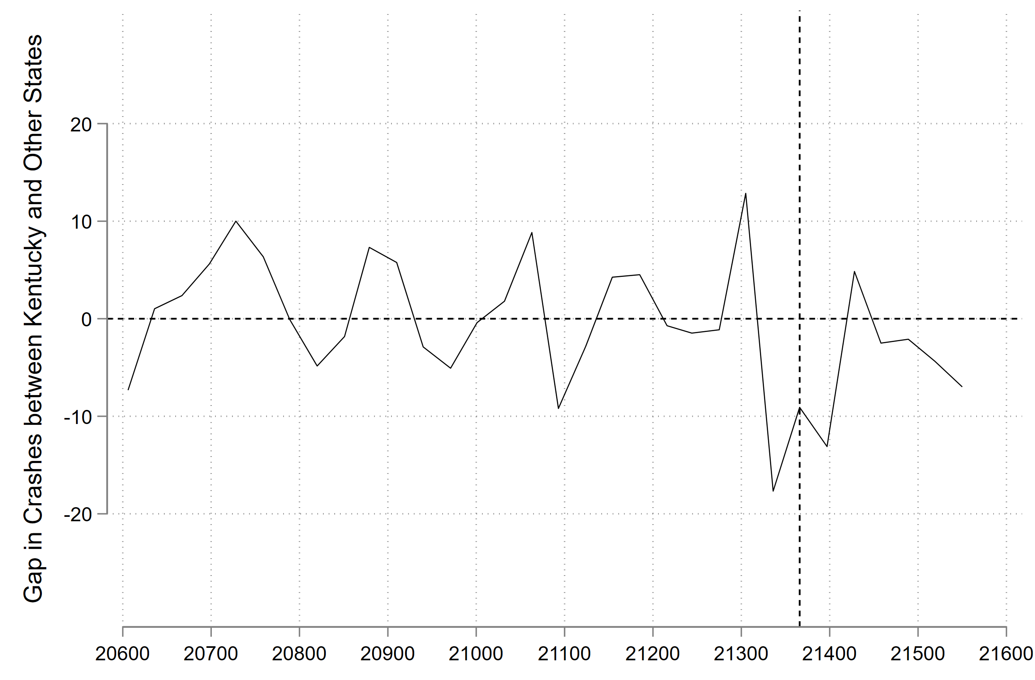
Generating Synthetic KY
Notes:
Note that the lines should line up and pre-treatment should be close to 0

Slide 9
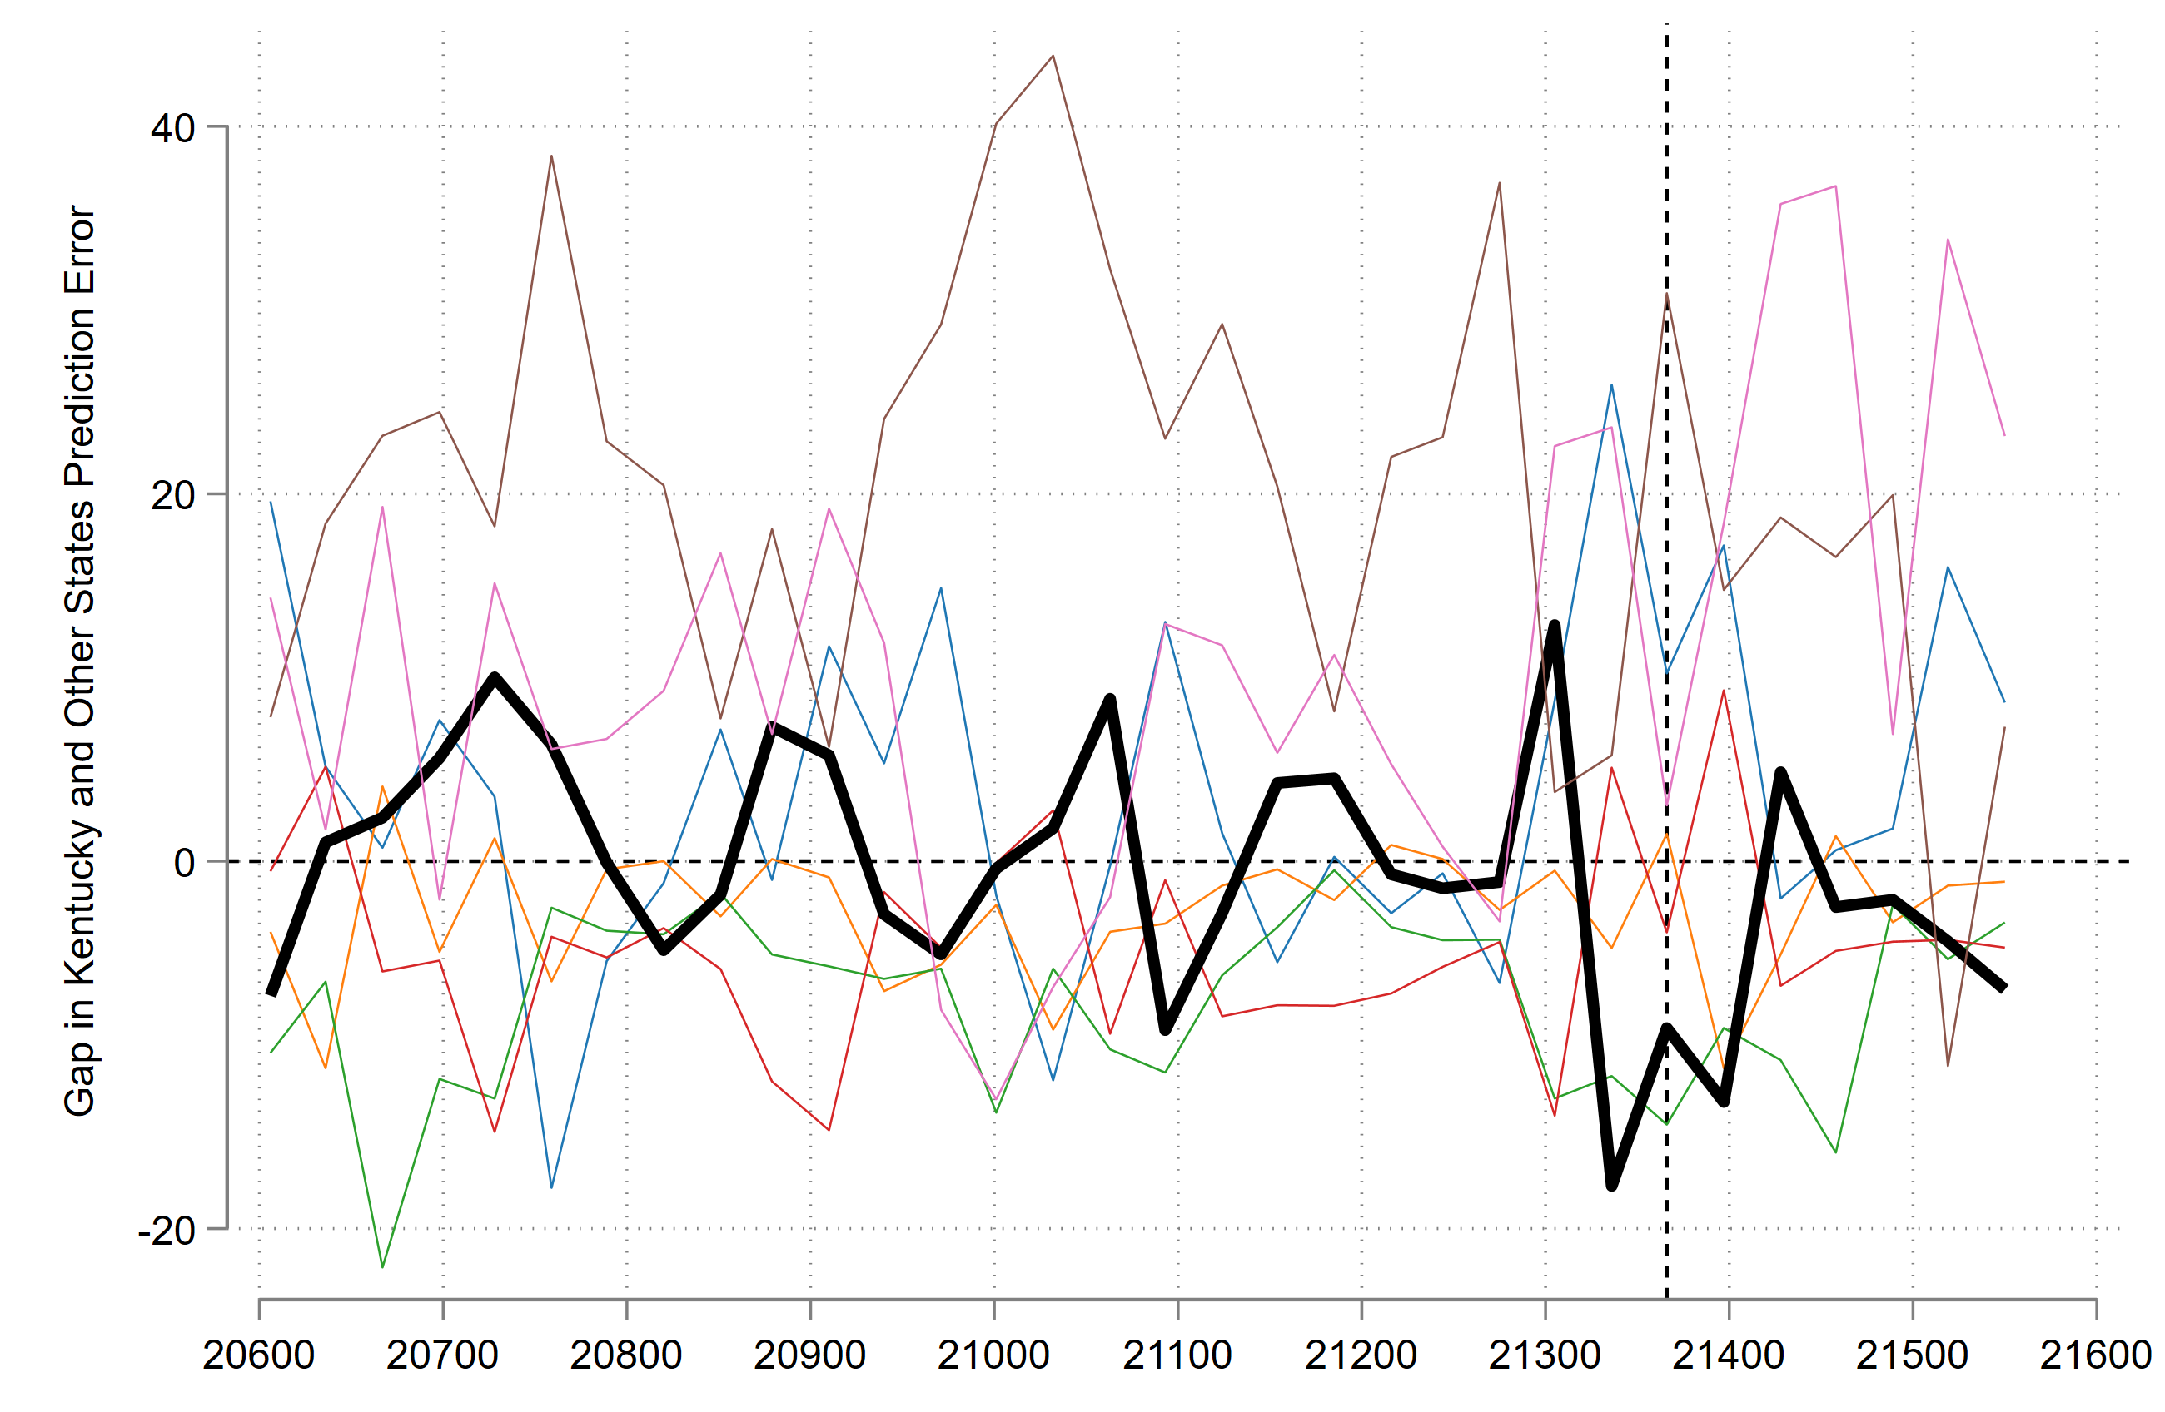
Gap Analysis: Kentucky and Placebos
The goal of the placebo test is to have the same specification for Kentucky applied to the other states
If the treatment effect is significant, we should see Kentucky (black line) in the far left or right tail

Slide 10
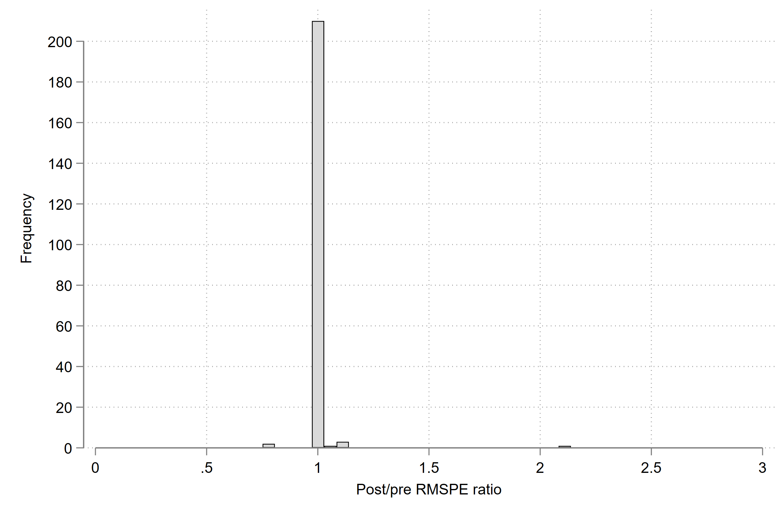
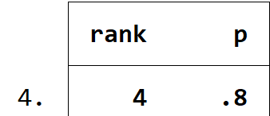
Analysis of Results
With the current data, Kentucky ranks #4 for its ratio, with a p value of .8 at the treatment effect, meaning the result is not significant

Slide 11
Future Research
1
Add more data – include more state data and covariates
2
Dig into the cause of the motor vehicle accident
3
Add more specification to ensure robust results

Slide 12
Future Research
4
Expand Synthetic Control to the other Lane Switching Law States (Delaware, Nevada, Oklahoma and Washington) and determine individual impact
5
Target percentage of total crashes

Slide 13

Questions?

